Slide 1
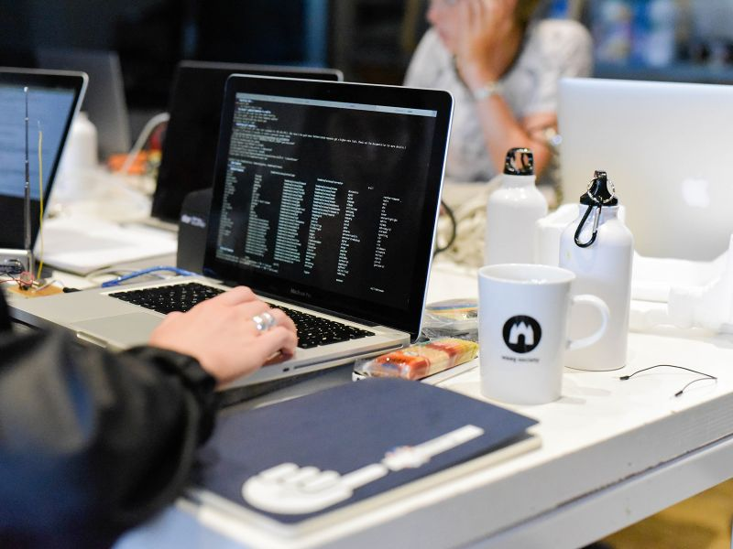

ClojureBridge
Notes:
Introduce ourselves
1. thank participants and tutors for coming
2. Say a few things about host
3. ClojureBRidge – volunteer. Learn programming together
4. What is Clojure
5. Introduce ourselves
Round of introductions

Slide 2
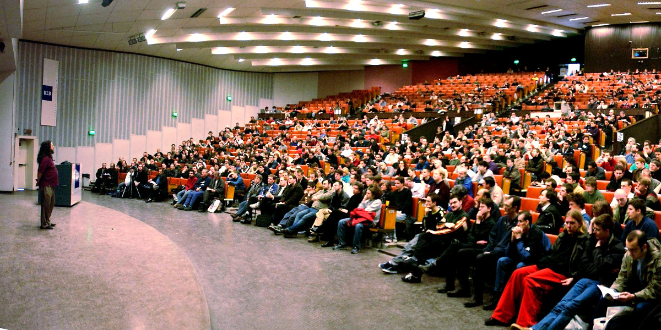
Lack Of Diversity In Tech
Notes:
FOSDEM 2018
Only white men like me. Erwin story. Analogy farming
Sexism Aspasia story. Software is made for all by few
We believe programming Clojure is for everyone.
- Not healthy
- scares people off that dont belong to this group
- The already working IT creates worse products

Slide 3
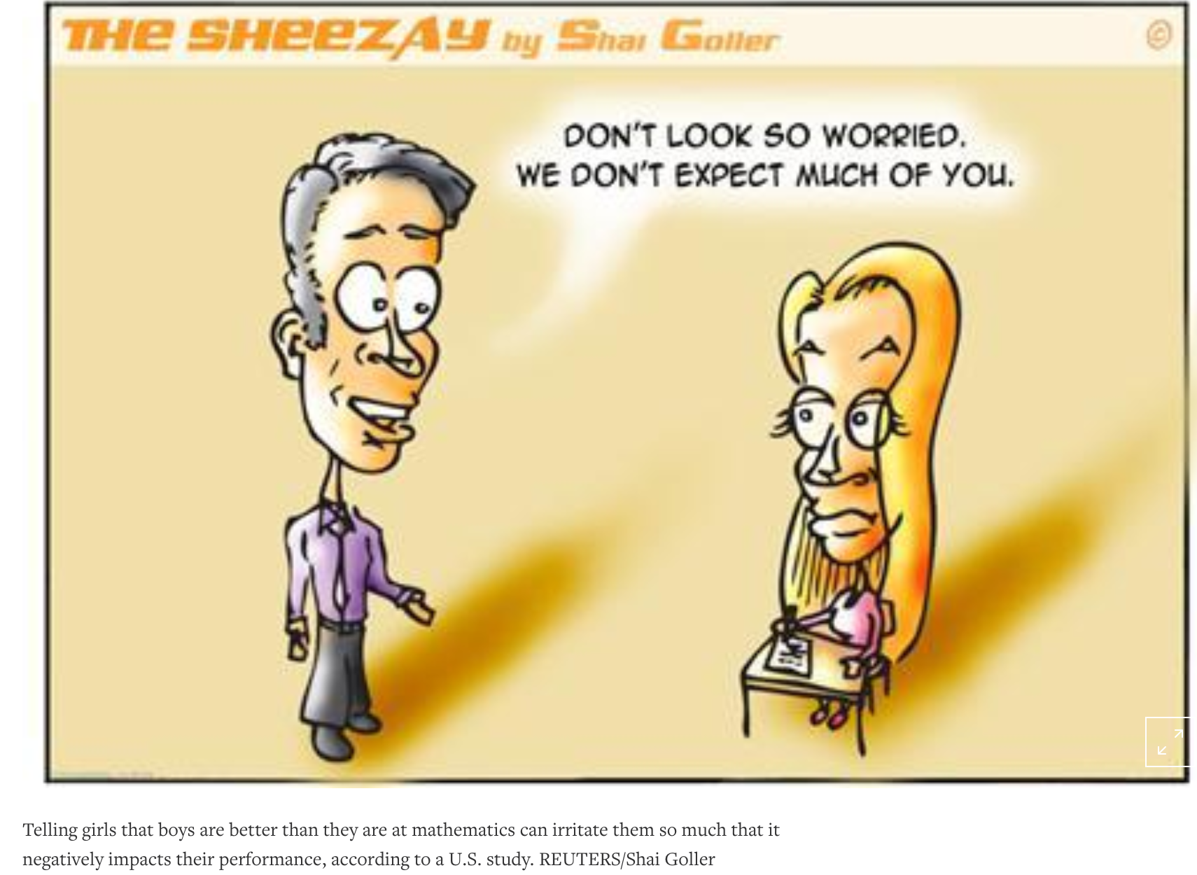
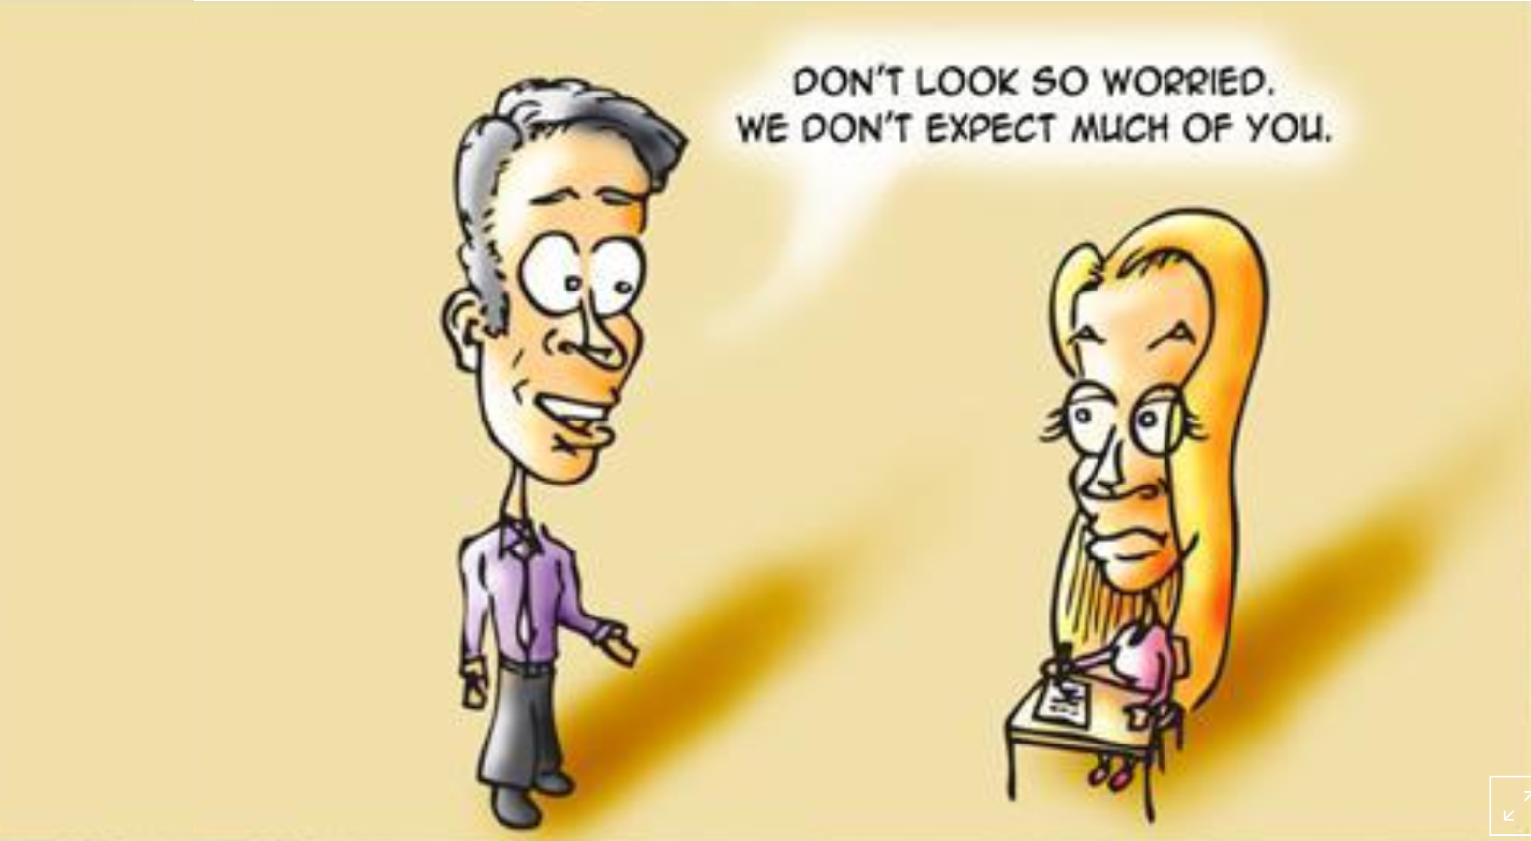
Telling girls that boys are better than they are at mathematics can irritate them so much that it negatively impacts their performance, according to U>S study. REUTERS/Shai Goller
Notes:
Example
People feel less empowered/insecure

Slide 4
Bias
Lazy
Offensive
Irresponsible
Destructive
Difficulty Understanding Non-native English speaking accents
Personal Assistants Als named after women or slaves
Women’s health issues not included in health apps
Facebook’s news feed algorithm shapes the public perception of social interactions and major news events
Algorithm being used to predict crime recidivism, and recommend sentencing
Let's Talk about AI, ML and Bias - Rebecca Parsons. Link: https://www.youtube.com/watch?v=w1lqZcnamAQ
Notes:
Worse outcomes
- mention example
Soap dispenser only responds to white skin
https://www.youtube.com/watch?v=YJjv_OeiHmo

Slide 5

Agenda
Welcome and introduction: what is programming?
20:00
Explain programming tools and web development components
20:15
Start coding! http://bridge.dyne.org/questions.html
20:30
Next workshop: 11 April (20.00)

Slide 6
What is Programming????
Notes:
Ask the public. See what they say.
2 mins discussion

Slide 7
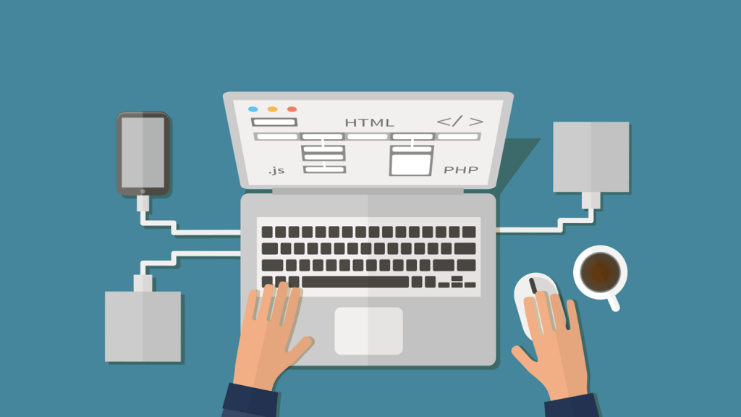
What is Programming????
Programs are a set of instructions for a computer to follow.
Computer programming is about expressing the instructions in a language that a computer can understand.
Programming is about splitting a big goal into sub-goals
Programs should be written for others to read!
Notes:
Explain breaking up a problem Programs that do something interesting enough that we would recognize -- like sending an e-mail, uploading a photo or making a restaurant reservation -- are, themselves, made up of many smaller programs.
Software developers often start with a big goal like "make a restaurant reservation application" and break it up into smaller pieces. In fact this process happens repeatedly until the pieces are tiny and bite-sized.
For other people to read as well
Because everyone likes to eat let's use preparing an <favourite meal from group> as an analogy. The goal is:
<favourite dinner, starter>
SPLIT IT UP IN SMALLER PARTS AND SPLIT THOSE PARTS UP AGAIN WITH THE GROUP
Now each of the steps (except maybe making the sauce :) is short and straightforward.
In computer lingo we would say that each of these steps are "functions": each is designed to accomplish a specific task. A "program" is just a big function that's built on top of lots of other little functions.

Slide 8

What do you need to program?
Notes:
This is what you get from it. And what helps.
Maths is a small part. It can help, but not the largest part. Problem solving is.

Slide 9
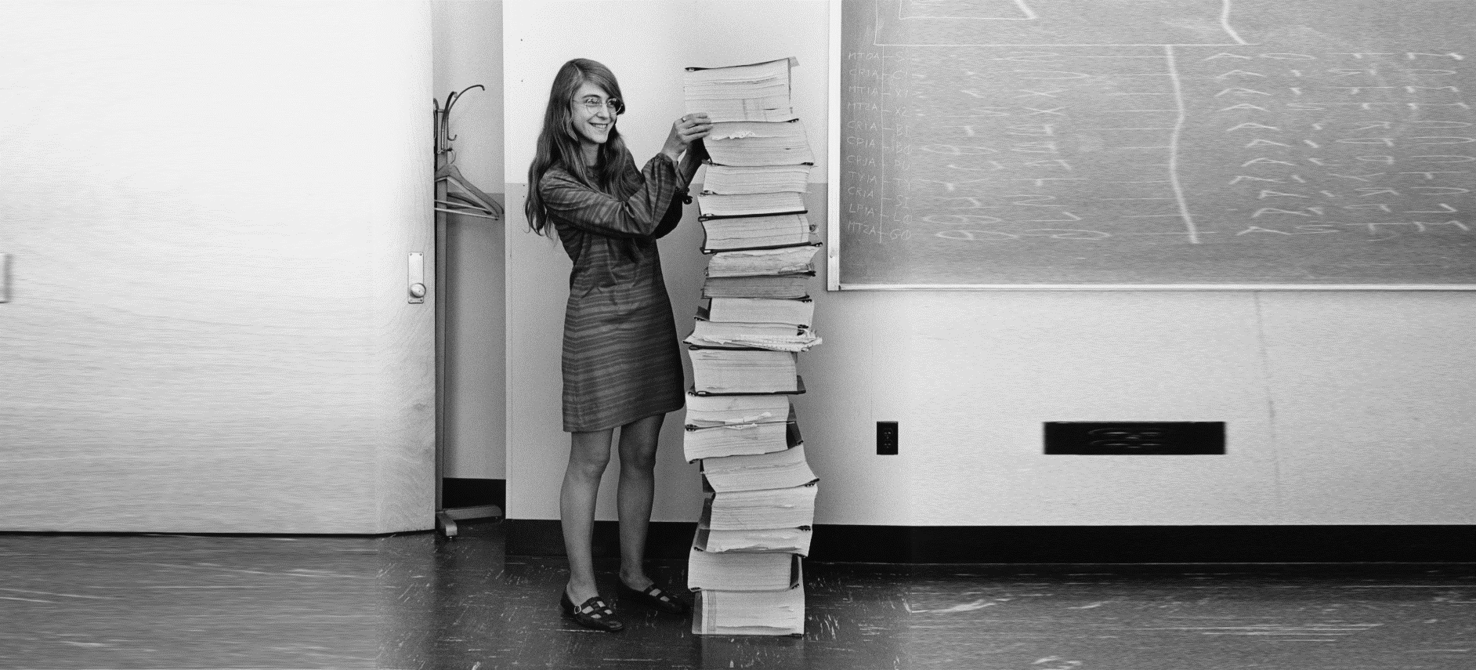
What is it used for?
Notes:
Ask the public
Margaret Hamilton in 1969, standing next to listings of the software she and her MIT team produced for the Apollo project.

Slide 10
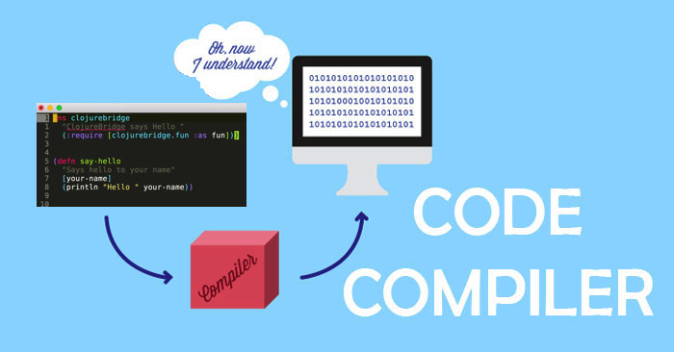
What Do You Need To Code?
Notes:
Text
Text editor
Compiler

Slide 11
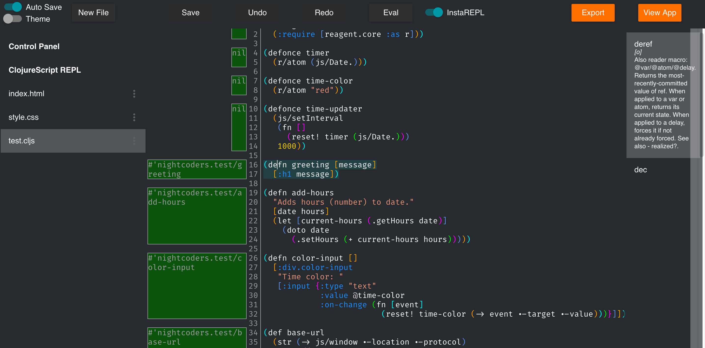
What do you need to code? An IDE.
Notes:
IDE Intelligent Development Environments
because:
Dark for the eyes.
Autocompletion for help
View documentation

Slide 12
Let’s Start!!!
Go to http://bridge.dyne.org
Clojure: http://cljs.info/cheatsheet/
Notes:
Compiler is in the browser. See result immediately.

Slide 13
Maria.cloud
Go to https://www.maria.cloud
Use command-enter or control-enter to evaluate
You can change the code in the white boxes and evaluate it
Ask if you need help
Notes:
Maria.cloud.
Explain things that are asked a lot on the white boards

Slide 14
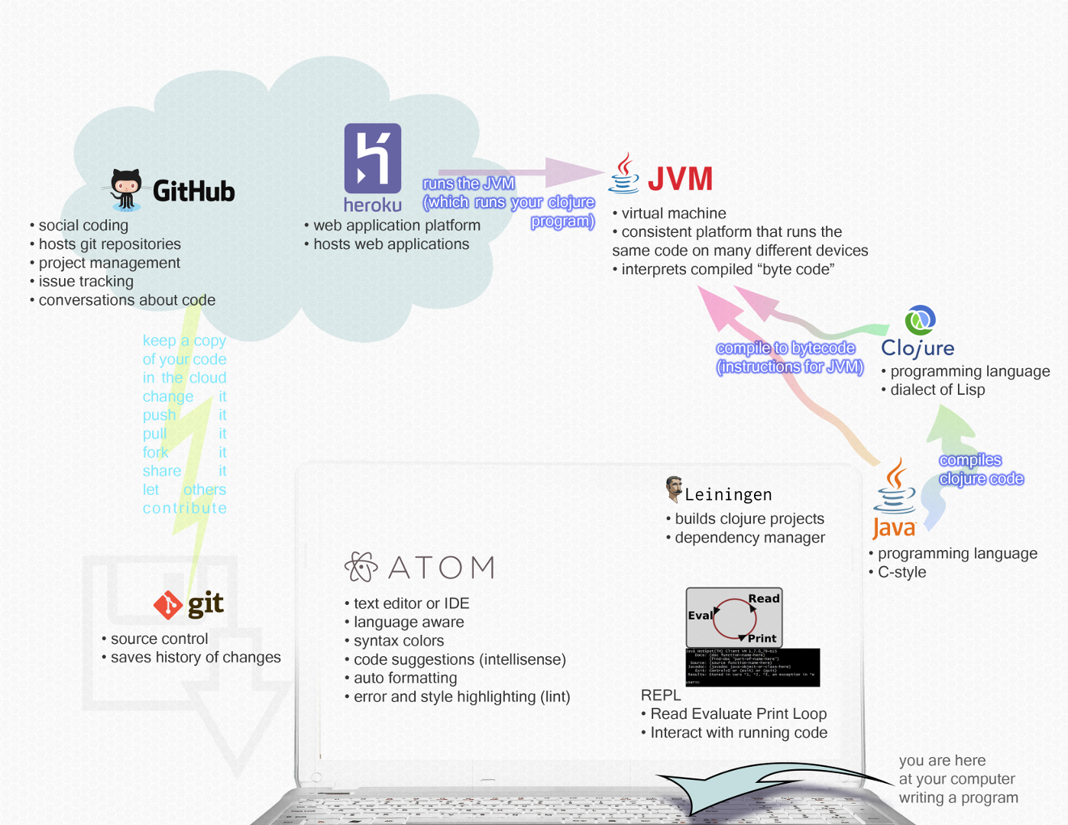
Advanced: coding environment

Slide 15
Thank you
We’ll put the slides on meetup:
Clojure for the Brave and True E-book: http://www.braveclojure.com/introduction
Clojure from the ground up: https://aphyr.com/posts/301-clojure-from-the-ground-up-welcome
Explanation videos on https://www.youtube.com/user/ClojureTV
Exercises from easy to difficult at http://www.4clojure.com/

